Slide 1
amazon
Big Blue Data Academy
PROJECT 1
By
Lama Katerina
Polydoros Manos
Mamatsopoulos Themis

Slide 2
amazon
The subject
Amazon Sales
Between 01/01/2020 and 29/12/2024
Which countries are the sales deployed ?
What is the distribution of each country to Sales
How are orders dispersed into countries
Product categories
How are they ranked through sales?
How are orders distributed trough categories
Categorized sales per Country

Slide 3
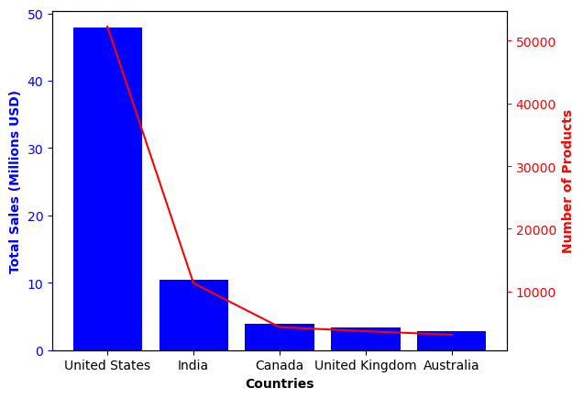
Sales per Country

Slide 4
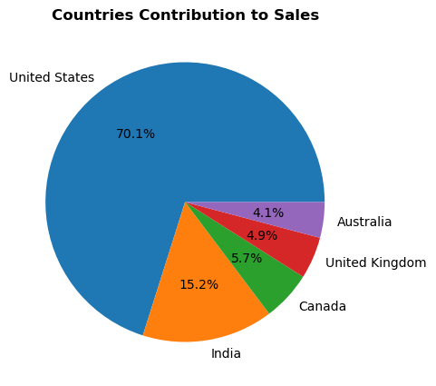

Countries contribution to sales

Slide 5
United States Sales

Slide 6
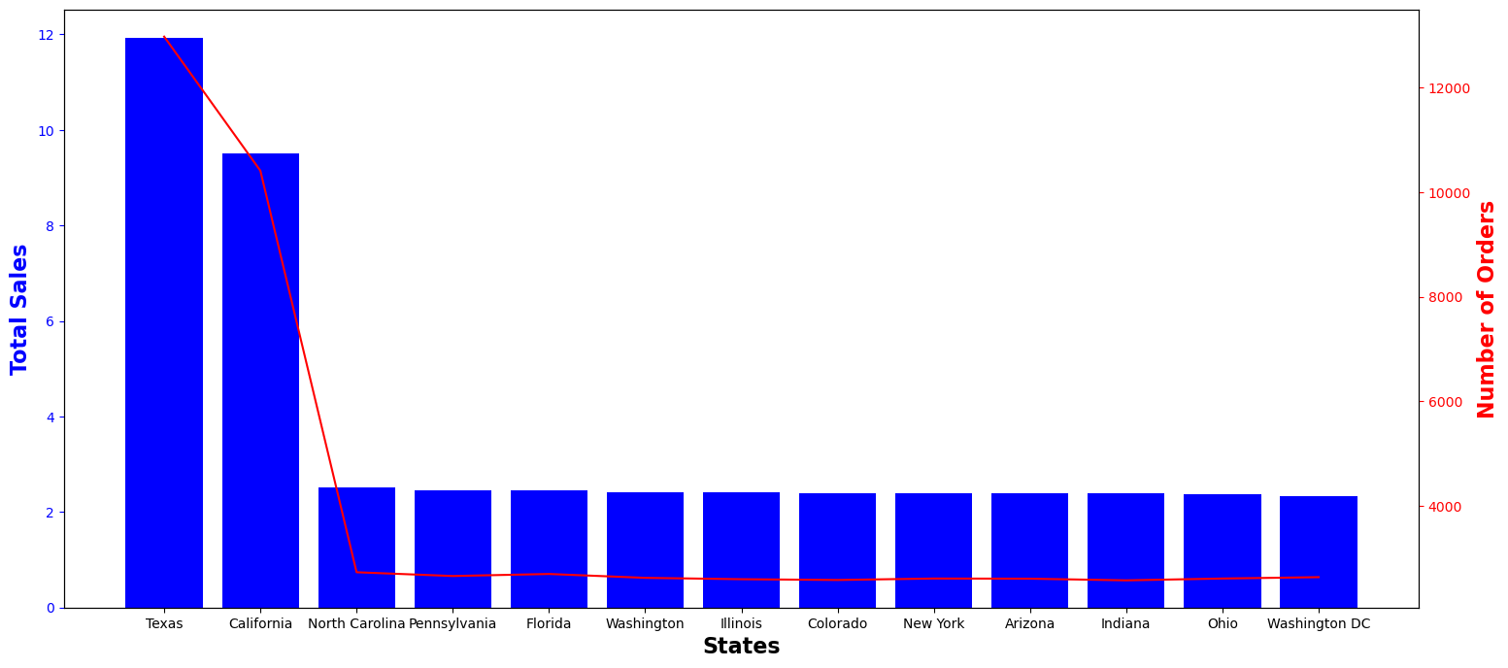
United States Sales

Slide 7
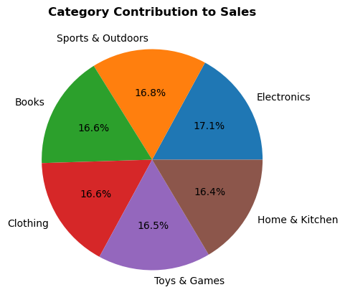
Sales per Product Category

Slide 8
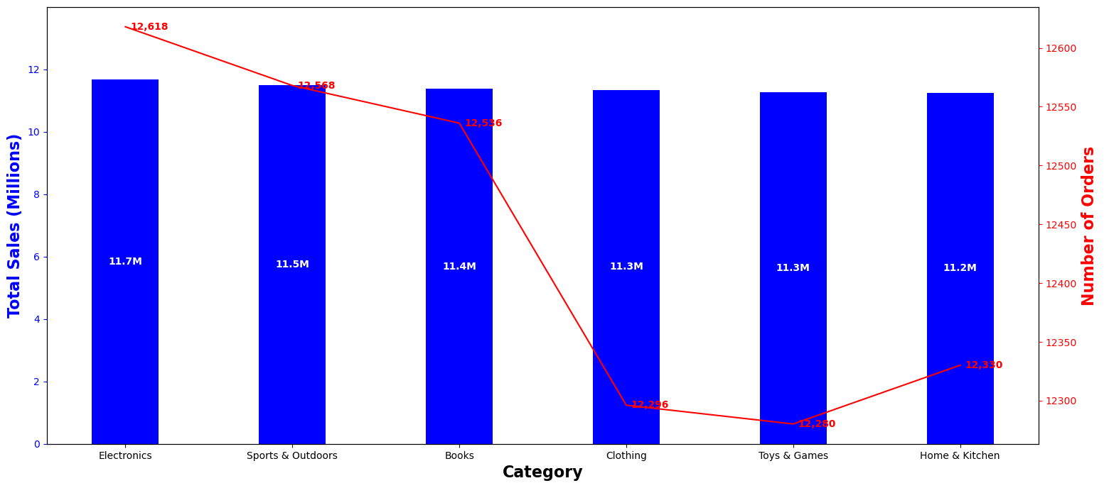
Sales per Category

Slide 9
RFM analysis attempt failed
More completed Data needed
Attempt to perform an RFM analysis failed
Due to Data limitations 70% of customers had only one order
Impossible to distribute in bins & frequency analysis failed
RFM analysis
rather inappropriate for Amazon orders
Only if additional data demonstrate more than one purchase per customer

Slide 10
01
What are the lowest sales
Per Country?
Per Category?
Category per Country?
02
What is the best strategy to follow?
Empower further our strong countries / categories
Boost sales in week countries / categories
Target new countries with old or new product categories
What’s next
03
A further analysis should be appointed for further insights extraction & data driven decisions

Slide 11
Thank you!

